Slide 1
Tate & LYLE PLC
INVESTOR PRESENTATION
OCTOBER 2019

Slide 2





Introducing Tate & Lyle
Our Strategy
Formed in 1921 following merger of Henry Tate & Sons and Abram Lyle & Sons
Member of
FTSE 250
Headquartered in London
Growing Food & Beverage Solutions by building leading positions in three categories globally – beverage, dairy, and soups, sauces and dressings – and in two or three additional categories in each region where we have expertise. Managing Sucralose to generate cash.
Driving value from Primary Products by optimising its portfolio to deliver steady earnings and generate cash.
      £2.76bn sales¹
      and
      £309m profit ^{1,2}
      Food, beverage, industrial and pharma customers in > 120 countries
Plants, labs and offices in
> 30 countries
18 application and technical service labs globally
Values
Behaviours
Safety
Integrity
Respect
Partnership
Agility
Execution
c.4,100
employees worldwide
~1.5m acres of corn processed in US each year
1 For the year ended 31 March 2019
2 Adjusted profit before tax
2

Slide 3

Our Purpose
Improving Lives for Generations
Through our purpose, we believe we can successfully grow our business and have
a positive impact on society. It inspires
us and informs what we do.
Working in partnership with our customers,
we use our ingredients, expertise and people to bring our purpose to life every day. We do this by helping people make healthier and tastier choices when they eat and drink, and lead a more balanced lifestyle.
Our purpose is our passion.

Slide 4

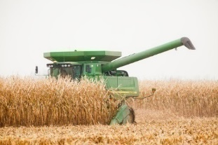
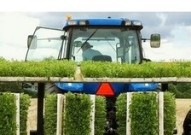
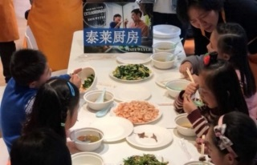
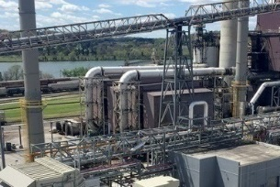
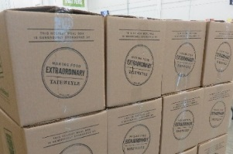



Sustainable business
Sustainable
farming
Responsible
supply chain
Healthier
lifestyles
Lower
emissions
Community
support
Research into sustainability of stevia supply chain
Child
health education programme in China
Providing nutritious meals for people
in need
Sustainable
acreage for
US corn supply
Co-generation
to reduce
CO₂e emissions
Nutrition
Society Shanghai
20.4%
reduction since 2008
300,000
meals donated last year
4

Slide 5



An Integrated Business
Business divisions
Food & Beverage
Solutions
Primary
Products
Shared customers
Provides solutions for customers globally that meet consumer demand
for healthier and tastier
food and drink.
Provides high volume
food and industrial
products primarily for customers in the
North American market.
Shared assets
…supported by
Innovation and Commercial Development
Global Operations
Support Functions
5

Slide 6
Investment Case
A clear strategy for our business…
FOOD & BEVERAGE SOLUTIONS
TOP AND BOTTOM LINE GROWTH
By building leading positions in:
Three global categories – beverage, dairy, and soups, sauces and dressings
Two or three additional categories in each region where we have local expertise
SUCRALOSE
MANAGE FOR CASH; RETURN ON ASSETS
PRIMARY PRODUCTS
STABLE EARNINGS AND CASH GENERATION
By managing its portfolio to:
Optimise product and category mix
Drive operational efficiency
Diversify into new and growing end‑markets
…driven by three priorities to accelerate performance…
SHARPEN – Focus on Customer
ACCELERATE – Portfolio Development
SIMPLIFY – and Drive Productivity
Product to category
Integrated commercial organisation
New product commercialisation
Partnerships and Open Innovation
More active focus on acquisitions
Drive faster decision-making
Integrated productivity agenda delivering $100m benefits
…to deliver returns for shareholders
Earnings per Share¹ – Accelerate growth
Organic return on capital employed² – Improve returns
Dividend – Maintain progressive dividend policy

Slide 7


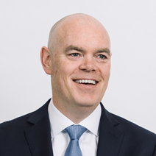

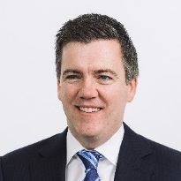



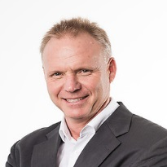

Strong Leadership Team
Nick Hampton
Chief Executive
Imran Nawaz
Chief Financial Officer
Jim Stutelberg
President,
Primary Products
Melissa Law
President,
Global Operations
Andrew Taylor
President, Innovation and Commercial Development
Laura Hagan
Chief Human
Resources Officer
Rowan Adams
Executive Vice President
Corporate Affairs
Lindsay Beardsell
Executive Vice President
General Counsel
Harry Boot
President, Asia Pacific, Food and Beverage Solutions
Driving pace, energy and ambition across the organisation

Slide 8
Summary
Stronger customer focus
Improving operational execution
Faster innovation
Productivity programme on track
Purpose-driven organisation
Increasingly dynamic culture
Three key priorities driving real momentum
Integrated business managed to optimise returns
Sharpen
Accelerate
Simplify
Purpose-driven | New leadership team | Dynamic culture

Slide 9


Food & Beverage Solutions
    Ingredients and solutions which add specific functionality and value to customers’ products
    Year ended 31 March 2019:
    Volume +3%
        North America +3%; ASPAC and LATAM +15%;
        EMEA (2)%
    Sales £889 million
    Profit £143 million¹
Value proposition
Growing global market
Provide solutions which make food healthier and tastier
Category expertise
Innovation capabilities
Local labs for local tastes
1 Adjusted operating profit

Slide 10


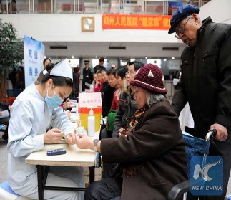



Food & Beverage Solutions:
Global Trends Driving Consumer, Customer and Government Actions
Trends
Actions
Obesity and Diabetes
70 million children
projected to be overweight
or obese globally by 2025¹
Reduce sugars by at least 5% over four years to 2020
Sugar Reduction
Plant Power
Reduce calories
by 20% by 2025
110 million diabetics
in China, estimated to increase to 154 million by 2040²
Regulatory Changes
Desire for Healthier Living
Adopt healthier meal options
as part of
‘War on Diabetes’
Clean Label
Global population
expected to grow
by a third by 2050³

Slide 11


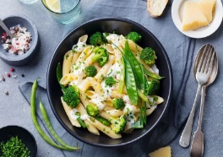
Food & Beverage Solutions:
Focus on Three Core Categories
Differentiated by the combination of our leading category expertise and ingredient knowledge
Dairy
Beverages
Soups,
sauces
and
dressings
CUSTOMER SOLUTIONS
Sugar and calorie reduction
Texturants
Enrichment
Stabilisation
Adding sweetness whilst reducing calories
Thickening and improving shelf-life, reducing fat
Adding nutrition (e.g. fibre)
Adding stability
and texture
(mainly in dairy)

Slide 12








Food & Beverage Solutions:
Delivering Value, Taste and Nutrition
Sweeteners
Replace sugars
Reduce calories
Match sweetness
Optimise product bulk and mouthfeel
Health & Wellness
Replace sugar to reduce calories while maintaining taste
Add nutrition through fibre enrichment
Value
Taste
Nutrition
Texturants
Add body and mouthfeel when sugars, fat or gluten are taken out
Improves shelf life
Provide stability
Improve sensory appeal

Slide 13
















Food & Beverage Solutions:
Accelerating Growth in North America
2014, ALMOST LOST ALL business. In 2018, Tate & Lyle were invited to become one of Mondelez STAR suppliers. This is the highest supplier segmentation possible at Mondelez, limited to just 17 suppliers across all their spend areas globally.
Winning
with Global Accounts
Winning in new customers/channels
Winning
with Innovation

Slide 14
Food & Beverage Solutions:
Maintaining Momentum in Emerging Markets
Geographic expansion model
Local labs serving local tastes
Get
Smart
Understand local trends and customers
18
Application and technical service
centres globally
6
Expanded or opened since
April 2017
>50%
Located in
emerging markets
Get
In
Build beachhead
with existing
products
Get
Ahead
Partner,
Innovate,
Upgrade
Invest and build local capabilities
Feet
on Street
Local
Labs
Global Processes
Local
Assets

Slide 15

Sucralose
    A high-intensity sweetener which offers sugar-like sweetness, stability and versatility
    Year ended 31 March 2019:
    Volume +16%
        Benefits of programme to optimise production and sale of excess inventory
    Sales £164 million
    Profit £61 million¹
        Softer pricing due to surplus industry capacity
        £3 million gain from supply contract
        Cost inflation in North America
Managed for cash and high return on assets
Market demand for sucralose continues to grow
Excess industry capacity, pricing pressure over time
Focus on customers who fully value benefits of our Sucralose
Finite capacity at single plant in US
1 Adjusted operating profit

Slide 16

Primary Products
    High volume ingredients which are largely undifferentiated and compete primarily on quality, service and price
    Year ended 31 March 2019:
    Volume in line
    Sales £1,702 million¹
    Profit £148 million¹
        Sweeteners and starches £126 million
        Commodities £22 million
Value Proposition
North American market stable in 5 years to CY2017, weaker in CY2018
Strong positions in sweeteners and industrial starches
Scale, cost competitive assets
Trusted supplier
1 Adjusted operating profit

Slide 17



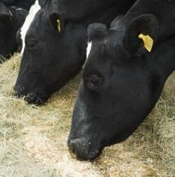
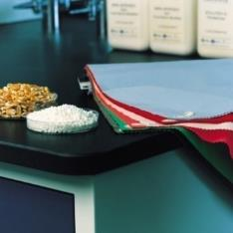
Primary Products:
What We Make
Sweeteners
Industrial
starches
Acidulants
Commodities
Joint
ventures
HFCS 55
HFCS 42
Corn Syrup
Dextrose
Adhesive starches
Coating starches
Binding starches
Strength starches
Citric Acid
Malic Acid
Fumaric Acid
Corn Gluten Feed
Corn Gluten Meal
Corn Oil
Ethanol
DuPont Tate & Lyle Bio-Products
Almex

Slide 18
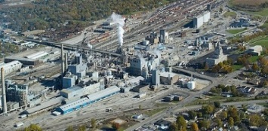
Primary Products:
Market Dynamics in 2018 Calendar Year More Challenging
Market dynamics
US corn wet milling industry
2012-17 calendar years
2018 calendar year
Stable demand
Decline in HFCS demand in US offset by exports to Mexico and corn syrup demand
Industrial starch demand stable with decline in paper offset by growth in packaging
Weaker demand
Volume in US regular carbonated soft drinks declined by 1.9%¹
Slightly lower US HFCS exports to Mexico
Commodities markets more challenging
1 Nielsen (compared to a 1.0% decline CAGR 2012-17; Source: IRI)

Slide 19



Primary Products:
Portfolio Management Driving Steady Earnings
Actions
Grind diversification
Capacity expansion
+20%
Complete mid-2019
    Customer, product and category mix
      Optimise customer and product mix
      Margin expansion opportunities
    Operational efficiency
      Capital investment to drive cost efficiencies
      Commitment to continuous improvement
    Grind diversification
      Move corn grind from declining to growing product lines
      Target new and growing end-markets
Product mix
Paper customer
Superior starch
Lower cost-in-use
Margin trade-up

Slide 20
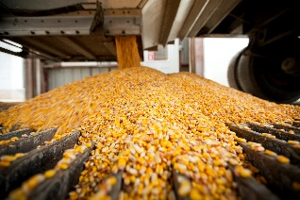
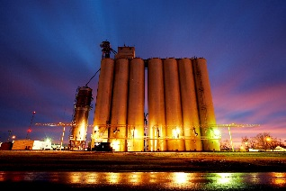

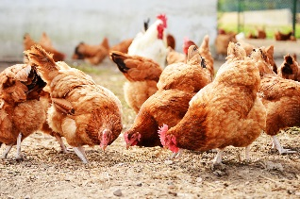
Primary Products:
Commodities
Principal activities
Dampening volatility
Corn procurement
Network of storage facilities
Sale of co-products
Conservative hedging strategy
Investments in elevator network to manage cost effectiveness and security of corn supply
Active management of co-product sales
Reduced ethanol exposure
Enables efficient operation of corn-based business for both divisions

Slide 21

Corn Wet Milling Process
Majority of our ingredients produced through corn wet milling
We have 6 major corn wet mills: 4 in US, 2 in Europe
Around 60% of a kernel of corn is starch. The remainder is co-products
Primary Products represent c.80% of
Tate & Lyle corn grind
Primary capacity
Corn Co-Products
Wet Milling
Starch
Corn Oil
Corn Gluten Meal
Corn Gluten Feed
Physical / Chemical modification
Glucose Syrup
Refining
Fermentation
Secondary capacity
Food & Beverage Solutions
Primary Products
Modified and Clean-label Food Starches
Soluble Corn Fibre
Crystalline Fructose
Maltodextrin
Corn Sweeteners
Dextrose
Industrial Starches
Citric Acid
Ethanol
Bio-PDO™

Slide 22
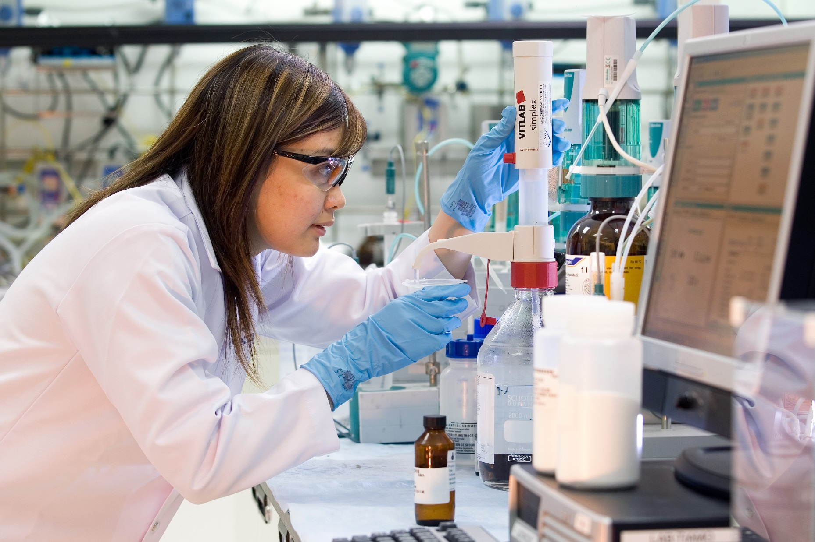
Innovation and Commercial Development
    Brings together scientific and commercial functions to provide an integrated approach to developing and commercialising new products
Critical growth enabler
Unique strengths drive innovation
Driven by consumer and category insights
Strong track record of commercial-ising innovation
Accelerating portfolio development

Slide 23
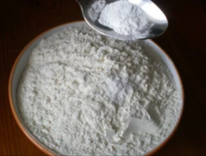



Innovation and Commercial Development:
A Key Enabler of Tate & Lyle’s Future Growth
ICD’s unique structure enables rapid
commercialisation of new ingredients and solutions
Platform
Strategy
Research & Development
Nutrition Science
and Regulatory
Open
Innovation
Partner with
leading customers
Rapid commercialisation
with Food & Beverage Solutions
Globally
connected

Slide 24


Accelerate Portfolio Development
Pipeline
Open Innovation
Open Innovation delivered five development agreements with external partners
Sweetener testing
New sources of dietary fibre
Positive FDA guidance
Tate & Lyle’s fibres included under new definition of dietary fibre
Allulose exempt from ‘Sugars’ and ‘Added Sugars’ line of Nutrition Facts Panel in US
More line extensions and next generation projects
More external partnerships to catalyse innovation
+24%
Increase in expected value
of innovation pipeline¹
>170
Contacts with start-ups and research institutions

Slide 25
Strong trajectory of innovation performance:
New Product Sales
131
New Product Sales (£m)
Three ingredients were removed from New Products during the year since they were launched more than seven years ago
+42% like-for-like sales growth in FY19 assumes those ingredients remain included in New Products
‘New Products’ are products launched within the last seven years.
2% growth in sales of
New Products in FY19
FY12 to FY19
CAGR 36%
‘New Products’ are products launched within the last 7 years
FY represents years ended 31 March

Slide 26
Appendix

Slide 27
Clear Capital Allocation Framework
Capital allocation priorities to maintain investment grade credit rating
Balance
Sheet
Invest in organic growth
Strong returns on
capital employed
Acquisitions, joint ventures, partnerships
Progressive dividend policy
Forward leverage¹
range of 1x to 2x
Return surplus capital to shareholders
Attractive shareholder returns

Slide 28
Disciplined Use of Capital
Investing to Grow
Capital expenditure mix
Capital expenditure
outlook
 | FY20¹ | Medium term
Capital Expenditure | £140m – £160m | £130m – £170m
Multiple of depreciation and amortisation² charge | 1.0x – 1.2x | 0.9x – 1.2x
Strong balance sheet gives investment flexibility
Invest behind growth as opportunities arise e.g. significant new product scale-up
Continued disciplined use of capital, expansion projects approvals typically target 20% IRR

Slide 29
Sources of Productivity Benefits
Produce,
Procure and Fulfil
Selling, General and
Administrative Efficiencies
Capital investment to reduce costs
~60%
Zero-based budgeting
~40%
Continuous improvement
Supply chain / Procurement
Simplify organisation
to make faster decisions
Operational reliability
US$100m productivity benefits evenly phased over 4 years

Slide 30
Cautionary Statement
This presentation has been prepared solely to provide information to assess the Group’s strategy and should not be relied upon for any other purpose.
It contains certain forward-looking statements with respect to the financial condition, results, operations and businesses
of Tate & Lyle PLC. These statements and forecasts involve risk and uncertainty because they relate to events and depend upon circumstances that will occur in the future. There are a number of factors that could cause actual results
or developments to differ materially from those expressed or implied by these forward-looking statements and forecasts.
With regard to the regulatory or labelling status of any ingredient referred to, this presentation contains our good-faith assessment of the matters discussed, based on information available as at the publication date; legal, regulatory and labelling policies and requirements are subject to change and vary in different jurisdictions; recipients of this information should take their own advice in each relevant jurisdiction with regard to the legal and regulatory aspects of our food ingredients.
A broader outline of the risk factors relevant to Tate & Lyle’s business and a glossary of some of the terms used in this presentation can be found within our 2019 Annual Report which is available on our website.

